Slide 1
Time Series Based Trend Analysis for social media content
H.M.M.Caldera

Slide 2
Problem Justification
Some of social media content (posts etc.) having a small life cycles.
These are ending in short time
Though it is short time it can have high impact soon
Having a predefined trend for those posts can helpful for identification if there any unwanted stuff posted in the social media platforms

Slide 3
Proposed Solution
Identification of deterministic components
Trend and seasonality components
Identification of Cyclical component and Seasonal component
Define forecast trend accordingly

Slide 4
Proposed Mechanism to Evaluate Solution
Problem divided into main three mechanisms and evaluation
Seasonality trend
Hourly sensitivity trend
Demand forecast using moving average

Slide 5
Decomposition of time series
Pt = f (Gt , St , Rt)
Pt - Time series value. Based on the posting time
Gt - General movement of the post
St - seasonal component
Rt - Residual component

Slide 6
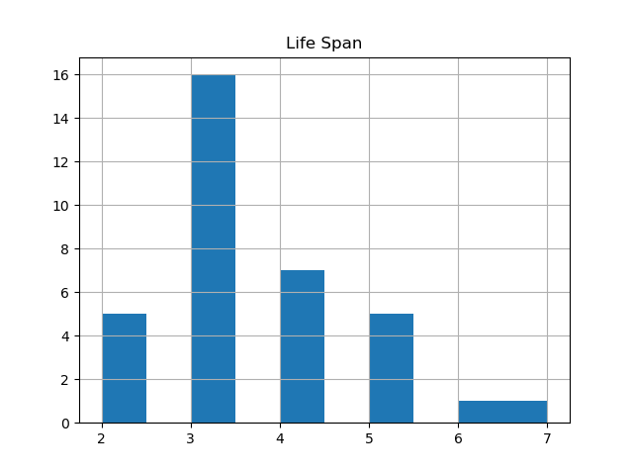
Overall life span of timestamps

Slide 7
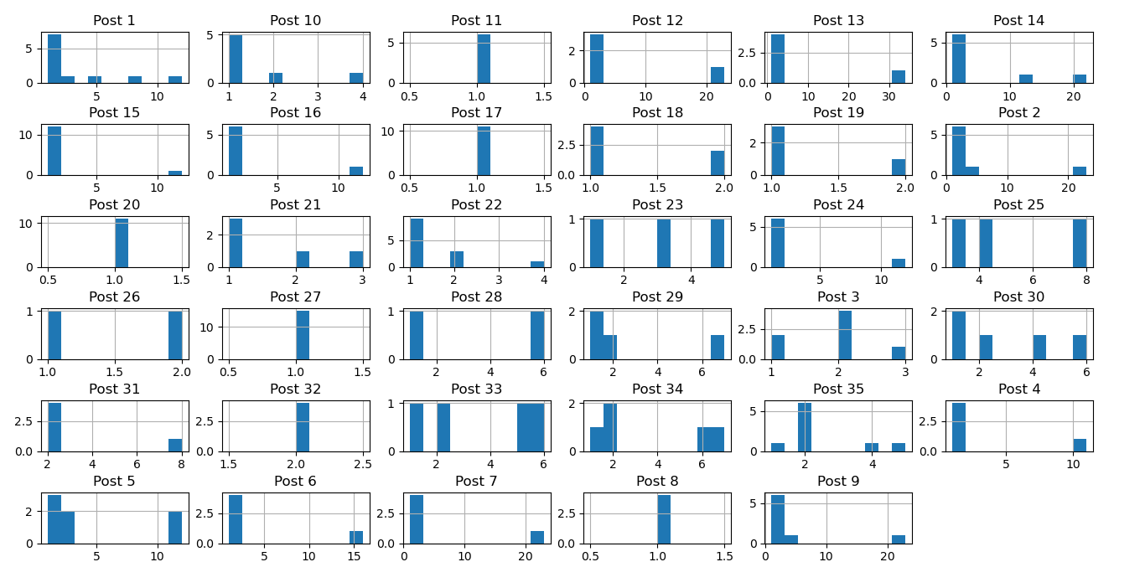
Analysis of each post time stamps

Slide 8
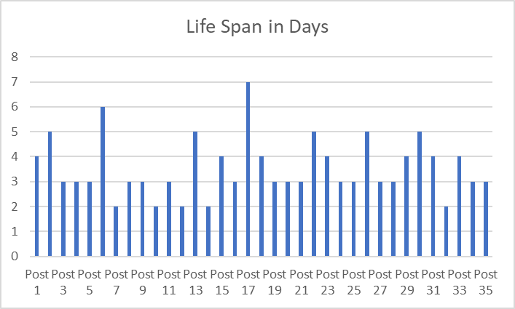
Overall life span

Slide 9
Summary statistics
The mean in both tests executed in highly independent values are no correlation was found.
Generated variance not coupled highly. Hence, these statistical values considered a non-stationary time series.
Test | Mean | Variance
Test 1 | 8.556 | 2.914
Test 2 | 3.530 | 0.720

Slide 10
Augmented Dickey-Fuller (ADF) Test
The p-value is greater than 0.05. Hence Fail to reject the null hypothesis (H0).
ADF Statistic | p-value | Critical Values
6.735665 | 0.9 | 1%: -3.639
 |  | 5%: -2.951
 |  | 10%: -2.614

Slide 11
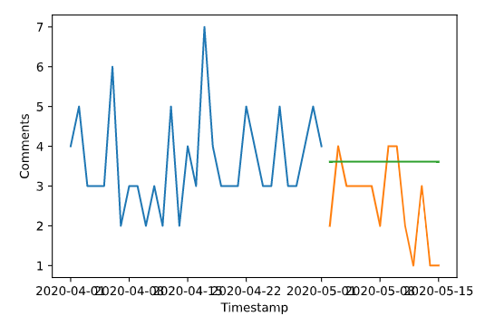
Exponential smoothing trend line

Slide 12
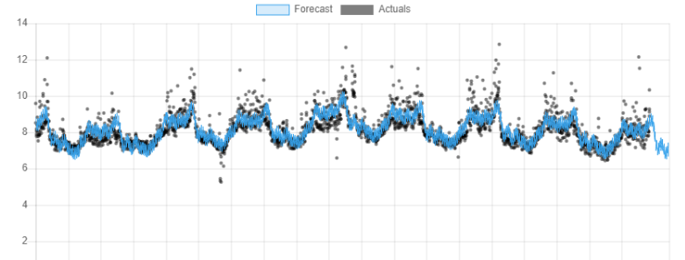
Hourly based analysis (liner forecasting)

Slide 13
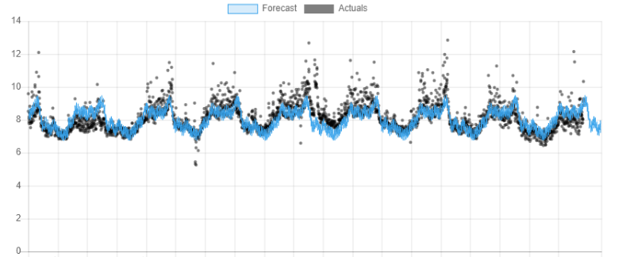
Hourly based analysis (logistic forecasting)

Slide 14
Conclusion
Time sensitive forecasting model tread line is highly non-sessonal
Predictive hourly solution is trend for limited time

Slide 15
Thank you

